Slide 1
Numbers Stations and OTP
Uncrackable Plain Text Over Short Wave Radio

Slide 2
What this IS..
Presentation on Numbers Stations
How one time pads are used for secure one-way communications
Brief exercise in manual one time pad creation and usage

Slide 3
What this is NOT..
An introduction into short wave radio operations
An introduction into amateur radio in general
A deep dive into encryption technology

Slide 4
Numbers Stations Explained
Unlicensed, anonymous, officially unrecognized one-way short wave radio broadcasts in the 20-60 meter bands (HF)
Broadcasts consist of mostly number strings read out by a synthetic voice or over Morse code.
Appeared shortly after WWII, imitating the same format used for weather report transmissions during the war
Two main types of broadcasts:
5 digit blocks, 5 numbers then a pause (most common)
3/2 digit blocks, distinct pause between 3rd and 4th digit of each group
Phonetic Stations – Alphabet spoken phonetically instead of numbers
Notes:
5 digit blocks follow the OTP methodology whereas the 3/2 digit system uses a dictionary code system
Phonetic stations read off alphabet strings using the phonetic system (Alpha, Bravo, Charlie, etc)

Slide 5
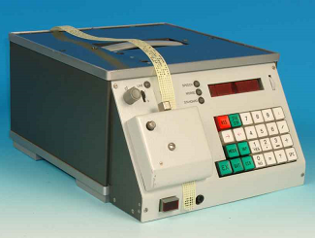
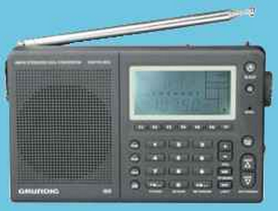
Numbers Stations Tech
High Power Short Wave Transmitter
Text to voice/Morse encoder
Short Wave Receiver
Broadcasts follow two well known crypto techniques
One Time Pad
Dictionary Code System (Appeared in the early 80s)
Notes:
East German Stasi “Stimme” text to voice synthesizer and short wave radio for receiving Numbers Stations broadcasts
Dictionary code system uses a pre-determined book available to the recipient. First 3 numbers are the page number, second set, line in the book, third set the word. This is ideal to prevent code books used in the OTP system from falling into the wrong hands.
https://www.youtube.com/watch?v=4buFLqjvTjA shows the Stimme in use.

Slide 6
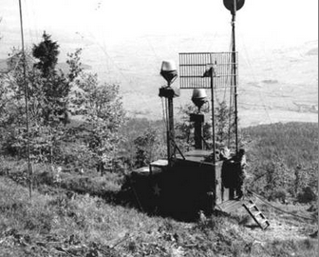
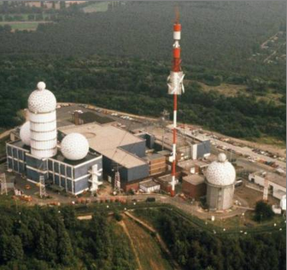
Numbers Stations Users
Most obvious: Government spy agencies
Less obvious: Drug cartels
Most common in North America are Spanish speaking stations
Notes:
Speculators claim some Spanish speaking numbers stations (usually with a live voice instead of Synthetic) are used by drug cartels for shipment information to receivers in the US.

Slide 7
How to Find Numbers Stations
Acquire a shortwave radio and a decent antenna OR
http://websdr.ewi.utwente.nl:8901/
http://www.hfunderground.com/board/index.php/board,7.0.html

Slide 8
Famous Numbers Stations
The Lincolnshire Poacher
Used tones from English folk song
British MI5 Numbers Station, broadcasting from Cyprus
First recorded in 1988, ceased in 2008
Replaced by Cherry Ripe in Asia
The Swedish Rhapsody (G2-YL)
German language numbers station
Used tones from The Swedish Rhapsody #1
Broadcasted in a small girl’s voice
Still broadcasting today
Notes:
Almost absolutely nothing is known about G2-YL (now E23) other than the broadcasts are in German. During the German floods of recent, the station went off the air, giving some idea of it’s location.

Slide 9
Famous Spy Cases
The Cuban Five (Wasp Network)
Attempted infiltration of US Southern Command
Received instructions from Atencion Cuban numbers station
Arrested in 1998 by the FBI after a code book copy in 1995
Walter Myers
US State Department Bureau of Intel and Research employee
Arrested in 2009 for spying for Cuba for nearly 3 decades
Received instructions from Cuban numbers stations
Notes:
The Cuban 5 infiltrated Alpha 66, The F4 Commandos, Brothers to the Rescue (a civilian aviation organization which flies over the Keys searching for Cuban exiles fleeing Cuba) and US Southern Command on Key West

Slide 10
The Conet Project
4 CD collection of Numbers Stations recorded throughout the 80s and 90s
Released in 1997 on Irdial-Discs record label
Freely available in MP3 format
5th CD included in a re-released pack 2013 includes noise stations
Also included:
STASI OTP Code Book Samples
Detailed photographs of voice synthesizers
Notes:
You don’t need a short wave receiver to hear the spooky broadcasts coming from Numbers Stations. The Conet Project has detailed recordings of such broadcasts and is well worth a look see.
http://irdial.hyperreal.org/the%20conet%20project/disc%201/
http://irdial.hyperreal.org/the%20conet%20project/disc%202/
http://irdial.hyperreal.org/the%20conet%20project/disc%203/
http://irdial.hyperreal.org/the%20conet%20project/disc%204/

Slide 11
Numbers Stations in Popular Culture
Movies
The Numbers Station – 2013
Vanilla Sky – 2001
TV
Fringe
Lost
The Americans
Video Games
Call of Duty: Black Ops

Slide 12
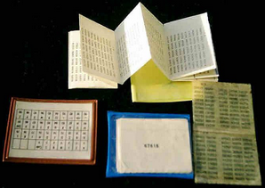
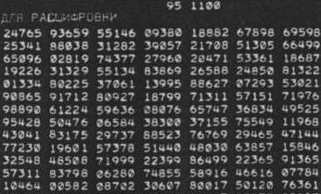
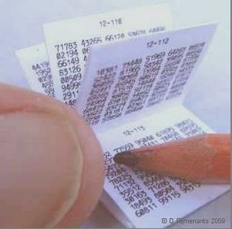
One Time Pads Explained
Also called Vernam-cipher or the perfect cipher, OTP is a crypto algorithm where plaintext is combined with a random key.
It is the only known method to perform mathematically unbreakable encryption. (Assuming all the rules are followed!)
Not to be confused with One Time Key or One Time Passwords

Slide 13
One Time Pad Rules
The key is at least as long as the message or data that must be encrypted.
The key is truly random (not generated by a simple computer function)
Key and plaintext are calculated modulo 10 (digits), modulo 26 (letters) or modulo 2 (binary)
Each key is used only once, and both sender and receiver must destroy their key after use.
There should only be two copies of the key: one for the sender and one for the receiver (some exceptions exist for multiple receivers)

Slide 14
Manual One Time Pads: 4 ‘Easy’ Steps
Step 1: Creating the OTP
Step 2: Preparing the Message
Step 3: Encryption and Decryption
Step 4: Follow the rules!

Slide 15
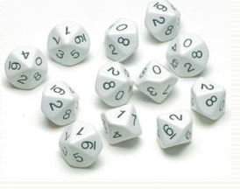
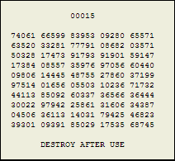
Step 1: Creating the One Time Pad
Hardware Random Number Generator
Software Random Number Generator
Dice Method
Default OTP usually contains 50 groups of 5 random digits, with the first 5 digits identifying the key to be used.
One-way communications need an OUT (sender) and IN (receiver) identical OTP

Slide 16
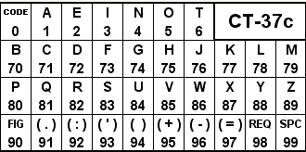
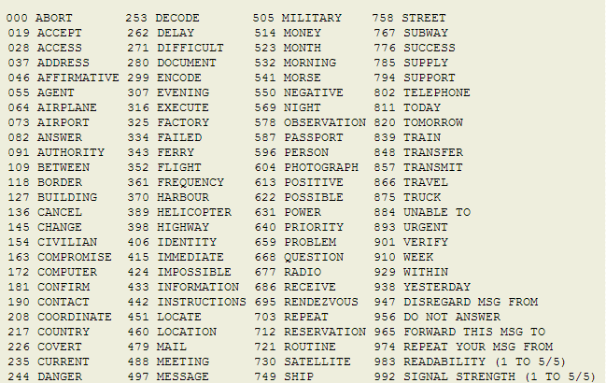
Step 2: Preparing the Message
Conversion from text to numbers
CT-## based on the number of characters they support
CT-46 freeware conversion table
Code books can reduce the conversion time tremendously
Example:
HELLO WORLD.
75 | 2 | 78 | 78 | 5 | 99 | 86 | 5 | 82 | 78 | 72 | 91 =
75278 | 78599 | 86582 | 78729 | 19191
Notes:
Code books take terms/phrases and compress them into specific number groups so the words don’t have to be spelled out during transmission. Since the message will be encrypted, a code book does not need to be kept secret.
Always do full stops at the end of each message with additional periods (9191, for example)

Slide 17
Step 3: Encryption
First 5 digits are the key to be used, not used in the encryption, making it easier for the receiver to know which key to use.
Subtract the OTP from the plain text conversion
Subtraction performed without borrowing (e.g. 5-9 is actually 15-9, resulting in 6)
See example text
Notes:
Example shown on a separate pad since it won’t fit in the slides.
Example uses subtraction method, but other methods such as add, multiple, divide, etc are also methods for encipherment.

Slide 18
Step 3 (cont): Decryption
First 5 digits determine the key to use for decipherment
Add the OTP key back into the ciphertext
Addition drops the 1 (9+5 = 4, not 14)
Digits 1-6 are single digits, 7-9 are 2 digits, 3 digit code follows a 0 (from the code book, so 548 would be 0548)
See example text

Slide 19
Step 4: Follow the Rules!
Generate the OTP with truly random numbers
Never reuse a OTP for encryption!
Even if there are groups of numbers not used, destroy the sheet immediately after use!
A new message should be encrypted with a new sheet.
Never keep a sheet after decryption!
Never use a computer to decrypt messages!
Traces of the message remain resident.

Slide 20
Step 4 (cont): Follow the Rules!
Assume OTP is compromised if:
The pad is used more than once
The pad was - even temporarily - not under custody of authorized personnel or securely stored
A distributor or user is suspected to have violated security rules
The pad has been exposed intentionally or by accident to other people
The pad is lost or there is no proof of destruction
If there's any doubt about the current or past situation of the pad
Finally, if you don't know whether a one-time pad is compromised or not, it is compromised.

Slide 21
Other OTP Methods Not Covered Here
One Time Pads with letters
Secret Splitting
Visual Cryptography
Notes:
OTP with letters is the same process as numbers, only using letters.
Secret splitting is similar to the Blakely-Shamir key splitting methodology
Visual cryptography takes two or more bits of the same image and splits them up to a number of shares. Only with collusion can the recipients bring all parts back together to get the original image.

Slide 22
Resources Used
Numbers Stations:
http://www.dxing.com/numbers.htm
http://users.telenet.be/d.rijmenants/en/numbers.htm
http://websdr.ewi.utwente.nl:8901/
http://www.irdial.com/conet.htm
http://www.hfunderground.com/board/index.php/board,7.0.html
http://users.telenet.be/d.rijmenants/en/coldwarsignals.htm
OTP:
http://users.telenet.be/d.rijmenants/en/onetimepad.htm
http://users.telenet.be/d.rijmenants/en/table.htm

Slide 23
Presenter
Tommy
big.negrow@gmail.com
AOLIM: pr0ject25 (zero)
No MyFace, Linked-In, etc
I’d give you my call sign, but… (I’m afraid of Roxy!!)

Slide 24
Exercise
Decrypt the following message!
11503 | 10843 | 44446 | 11895 | 78891 | 46340 | 99471 | 87843 | 66352 | 25171

