Slide 1
I LIKE FANCY SLIDES
Because I Can, that’s why

Slide 2
Let’s Play: Is it infected?
Three examples of malware wackiness

Slide 3
Who am I
JimmyJohn
SysAdmin turned security enthusiast
(Thanks Angelina Jolie!)
Interested in Malware Research

Slide 4
First one is kind of obvious

Slide 5
Kuluoz.D? I think you mean … Kulu`LOL’Z! But seriously its not good

Slide 6
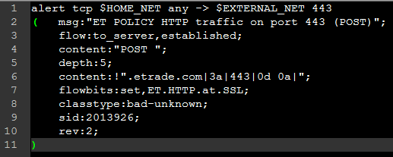
Win32/Kuluoz.D Checkin ALERT
First Contact…

Slide 8
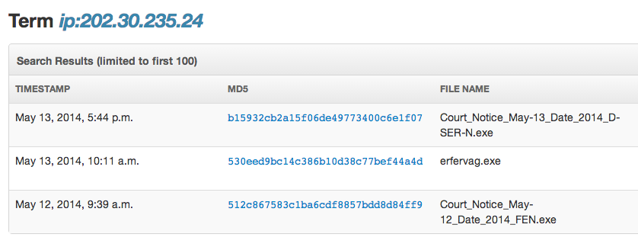
What more can we find out?

Slide 9
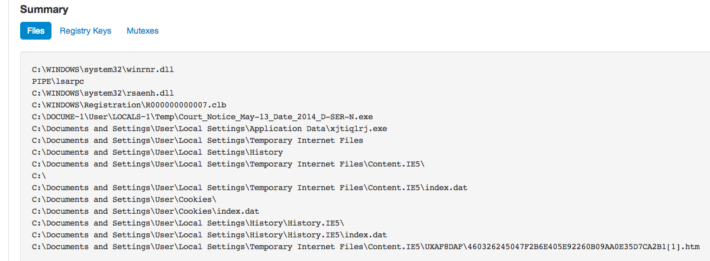
"Shoot it," said my attorney. "Not yet," I said. "I want to study its habits.”

Slide 10
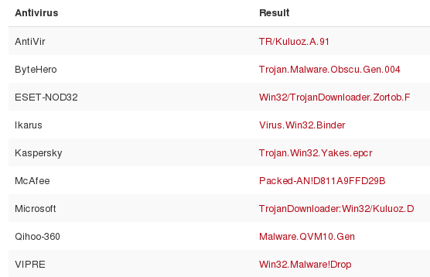
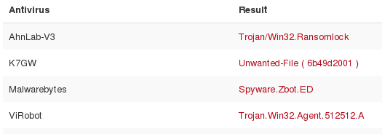
What do we find in that location?
dhbnwbgf.exe
cudmgthj.exe
mnaumjjk.exe

Slide 11
What’s this Mevade Crap?

Slide 12
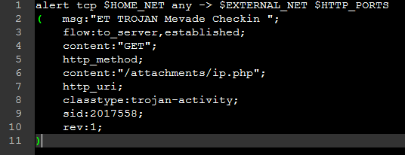
Mevade checkin alert
First Contact…

Slide 13
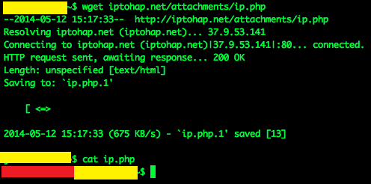

Slide 15
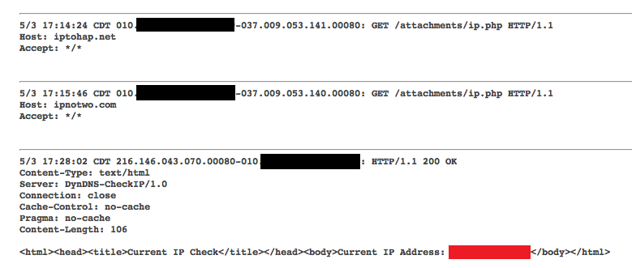
MEVADE Attempts to find out where its installed

Slide 16
WHAT ELSE CAN WE TELL?
Time to research

Slide 17
MEVADE Characteristics
Mevade.A installed via a fake Flash player update (FlashPlayerUpdateService.exe)
Mevade communicates with the C&C server using the following URL format:
http://{malicious domain}/updater/{32 random hexadecimal characters}/{1 digit number}
Mevade will use SSH over port 443 to exfiltrate stolen data via an encrypted channel
Mevade.B and Mevade.C have either abandoned SSH over 443 in favor of using Tor, or do not rely on it as much
This change came on August 19, 2014, on that date over one million new Tor users suddenly appeared, bringing to light a botnet which had previously been undiscovered! But nice try Mevade! Maybe next time!

Slide 18
Enter Argus
HI GUYS!
Argus is network monitoring software that tracks “network flows”, IE TCP sessions
When coupled with PF_RING in a Linux environment, a single process seems to be able to adequately monitor at least ~ 2 Gbps network links ( < 1% loss)
This is further reduced with the use of DNA specific drivers, but is not supported
Can capture the first X bytes of a TCP session, letting you reduce the size of archived network traffic to fit your needs
Oh yeah, its free, and is still very much maintained by one very awesome but kind of eccentric guy named Carter Bullard

Slide 19
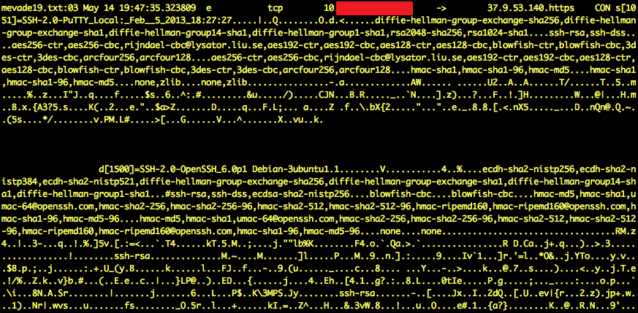

Slide 20
Should We have seen other alerts?
Short answer: yes … But no

Slide 21
Sources
http://threatpost.com/moving-to-tor-a-bad-move-for-massive-botnet/102284
http://blog.trendmicro.com/trendlabs-security-intelligence/us-taiwan-most-affected-by-mevade-malware/
https://blog.damballa.com/archives/2135
http://securityaffairs.co/wordpress/17601/cyber-crime/botnet-behind-tor-traffic-surge.html

Slide 22
Damn Jimmy – You’re two for two
BUT wait …
There’s more

Slide 23
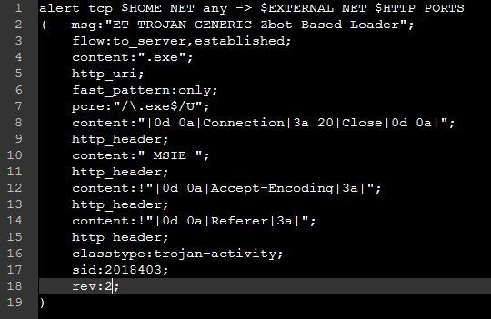
Oh No! ZBOT! … I Think!

Slide 24
Is this a Zbot?
No … that’s Adobe Flash Player
Is this a Zbot?
No … that’s Windows Updates
Is this a Zbot?
No … that’s Windows updates download through 360 Safe ...
Well maybe THAT one is a ZBot

Slide 25
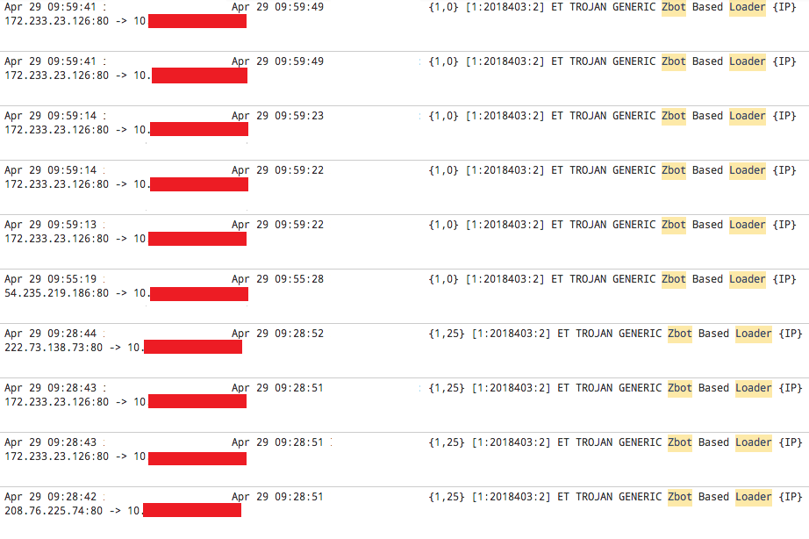
There are so many hits on this rule …

Slide 26
Wait a minute … What’S this one?
It’s a zbot … probably!

Slide 27
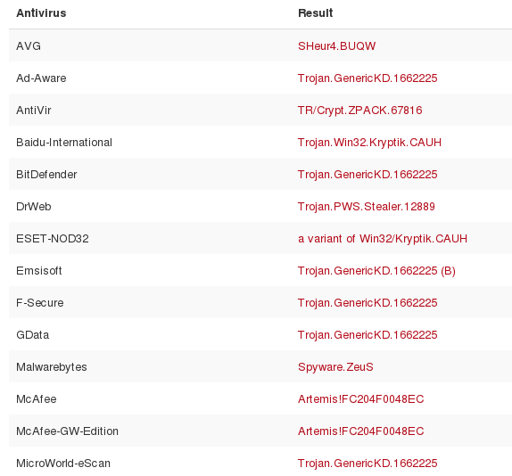

Slide 28
Moral of the Story, it’s probably not a zbot
But does it have to be?
Single rules are very tough to have confidence in
Need to look at overall behavior
Alerting needs to happen on data correlation

